Slide 1

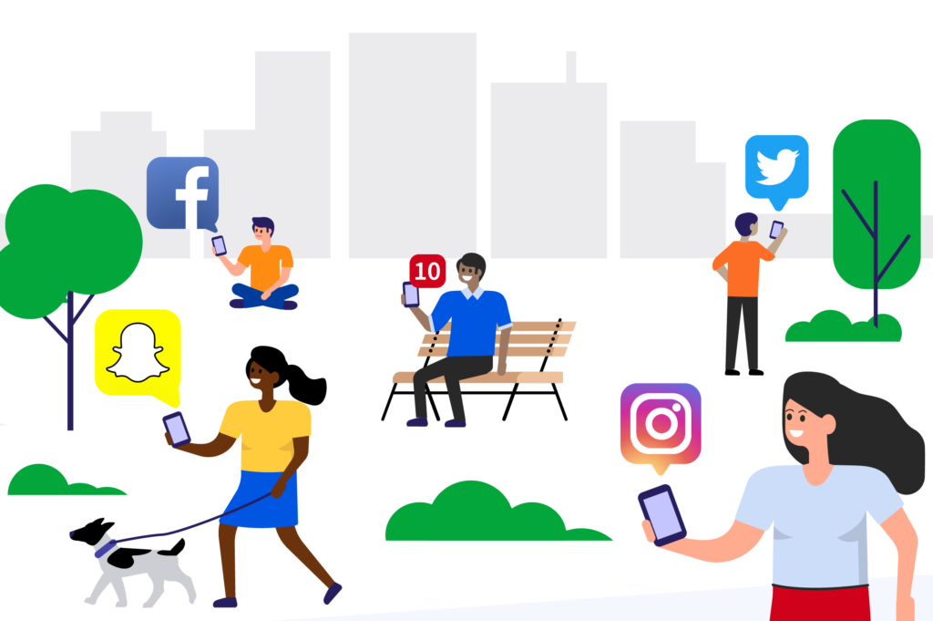
Is social media taking over our lives?
Team members:
Anna Wrobel
Latyr Thiao
Lujane Abdelgadir
Prajakta Galvankar
Stephen Zhang

Slide 2

Thanks for your attention !
Table of contents
Motivations & Summary
Process summary
Data Cleanup & Exploration
Data Analysis
Questions & Findings
Conclusions & Limitations
Q & A

Slide 3
Motivation & Summary

Slide 4
Main question: How dangerous is social media?
x
Main question:
Motivation:
Key questions to explore:
Sources of information:

Slide 5
Process summary

Slide 6
Process summary
x

Slide 7
Data Cleanup & Exploration

Slide 8
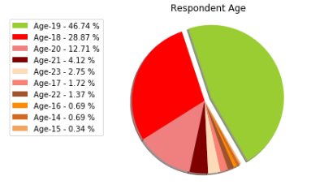
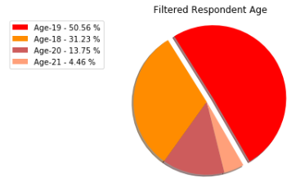
Data Cleanup & Exploration
We have applied a number of methods to clean up and organize the data
Filtered the data to focus on responses of 18 to 21 year olds ( > 4% ) in order to have a more meaningful profile of respondents:

Slide 9
Data Cleanup & Exploration
We have applied a number of methods to clean up and organize the data
Removed unnecessary columns in order to declutter the data and make it easier to read:
Removed timestamp
Removed empty columns
Looked for and removed unavailable/empty responses
Cleaned responses and streamlined iterations into one value:
One of the responses to types of cyber crime experienced was “Fake profile, none of the above”
Changed to “Fake profile”
Split the responses in order to count/tally the values:
For the responses that allowed for multiple answers, we split the answers using “comma separator” and tallied the results, this was applied for answers to:
Preferred social media
Preferred form of communication
Types of cyber crime experienced

Slide 10
Data Analysis

Slide 11
Data Analysis
2.1 xyz

Slide 12
Questions & Findings

Slide 13
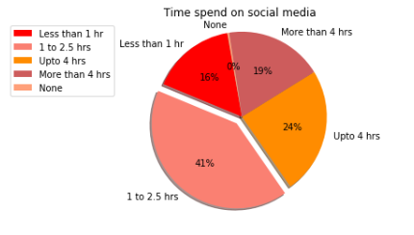
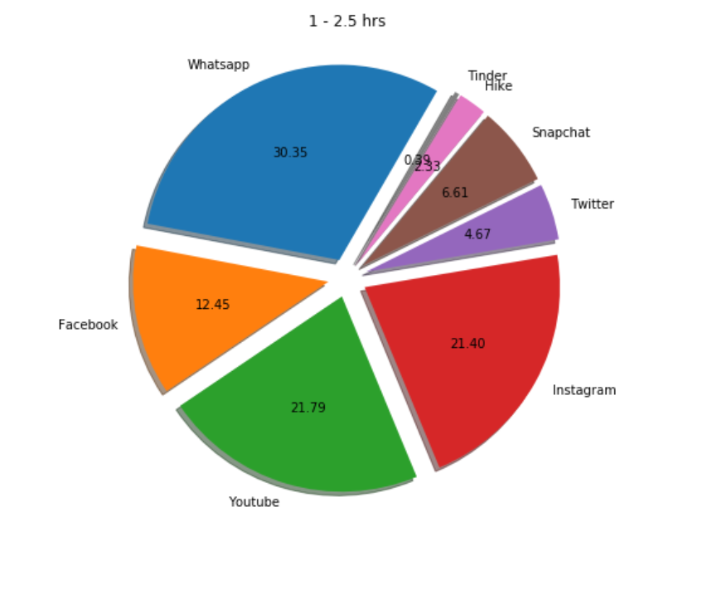
Which social media platform/s do you like the most or use the most?
2.1 xyz

Slide 14
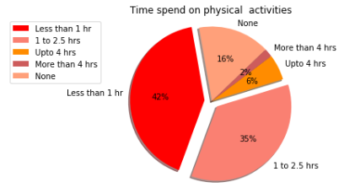
How much time is spent on social media vs physical activities?
2.1 xyz

Slide 15
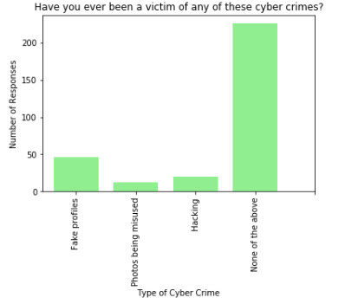
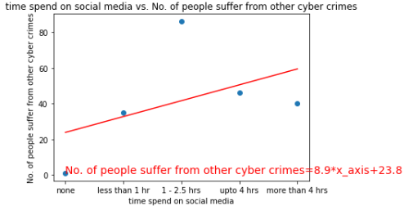
Have you ever been a victim of cyber crime?
2.1 xyz

Slide 16
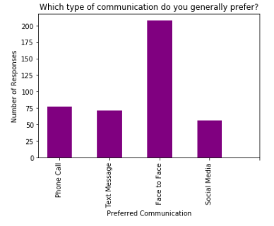
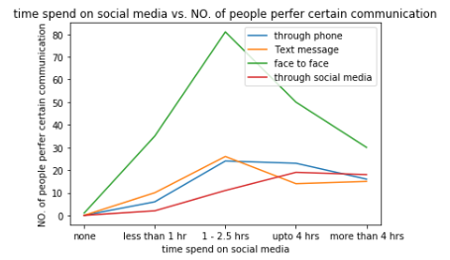
What type of communication is preferred?
The majority of respondents prefer face to face communication

Slide 17
Conclusions & Limitations

Slide 18
Conclusions & Limitations
Conclusions
Limitations & further research
People tend to underestimate the time they spend online.
The study did not cover exposure to scams, bullying, fake news..etc.
The study did not identify the geographical location of respondents

Slide 19
Thank you! Q & A

